Slide 1
Capstone Design II: Lessons Learned Presentation
Austin Williams

Slide 2
Table of Contents
Project Introduction and my Role
What went well
What went poorly and how those were addressed
Best Practices for Future Projects
Advice for Future Students
Knowledge or Skills Acquired
Impact on Approach and Aspirations

Slide 3
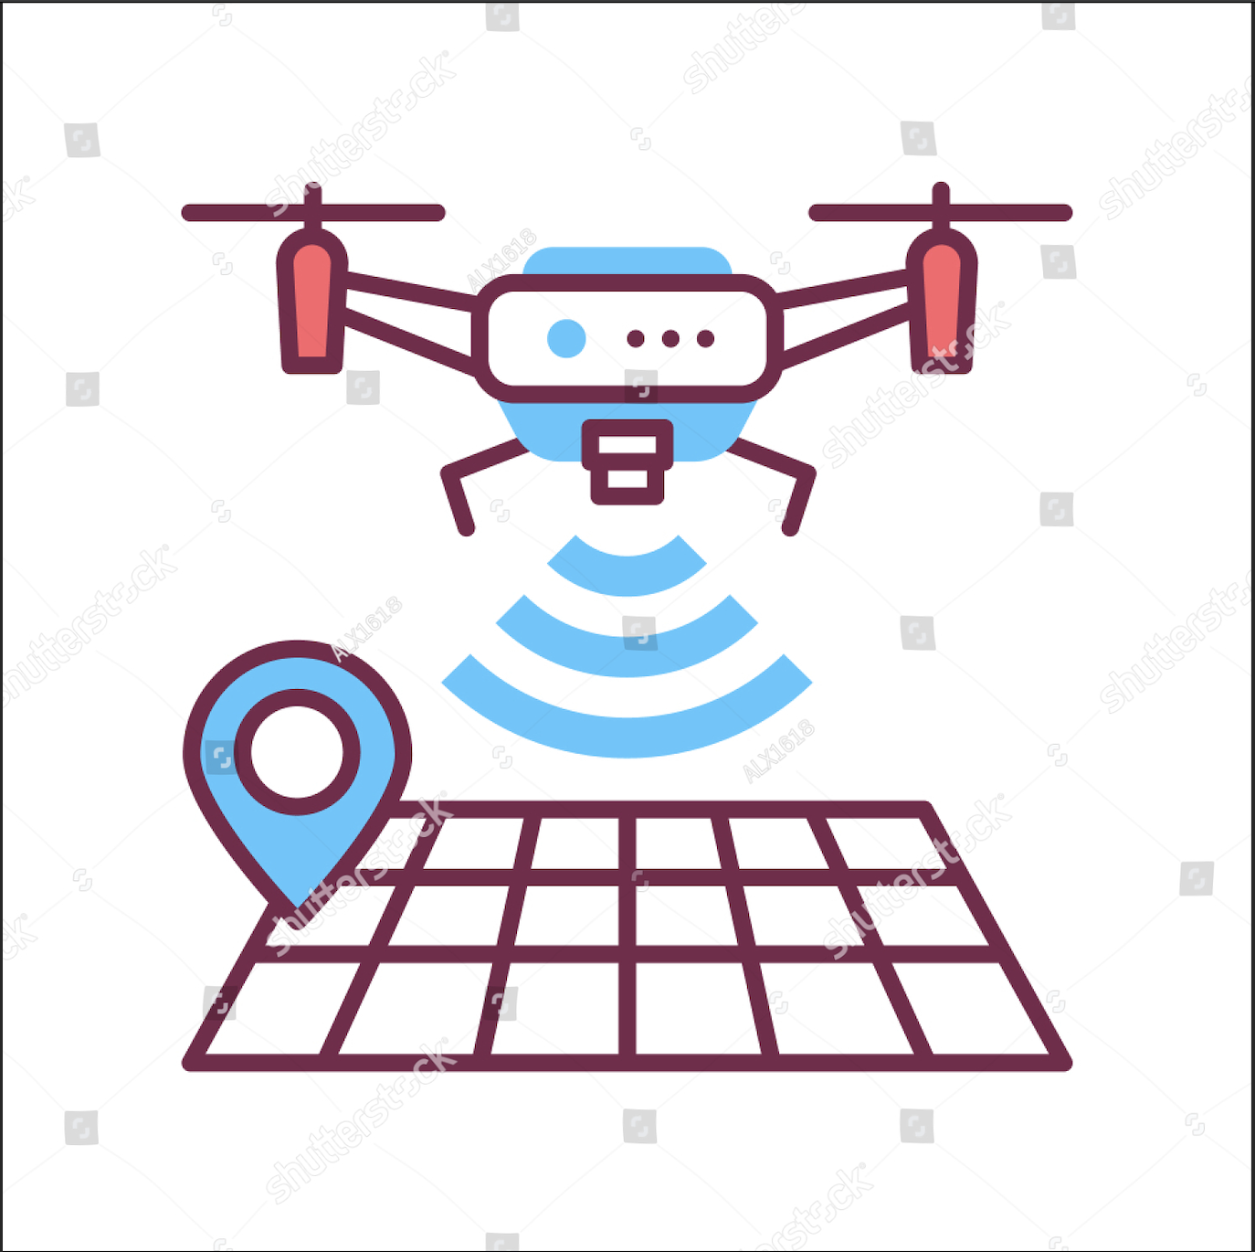
Team 1 – Drone Tracker
Team one is using the Remote ID signal emitted by drones to track drone usage on campus.
We are receiving information such as location, elevation, and speed.
We are also taking an image of the drone or its user.
That information is then stored and displayed to a website accessible by campus police.

Slide 4
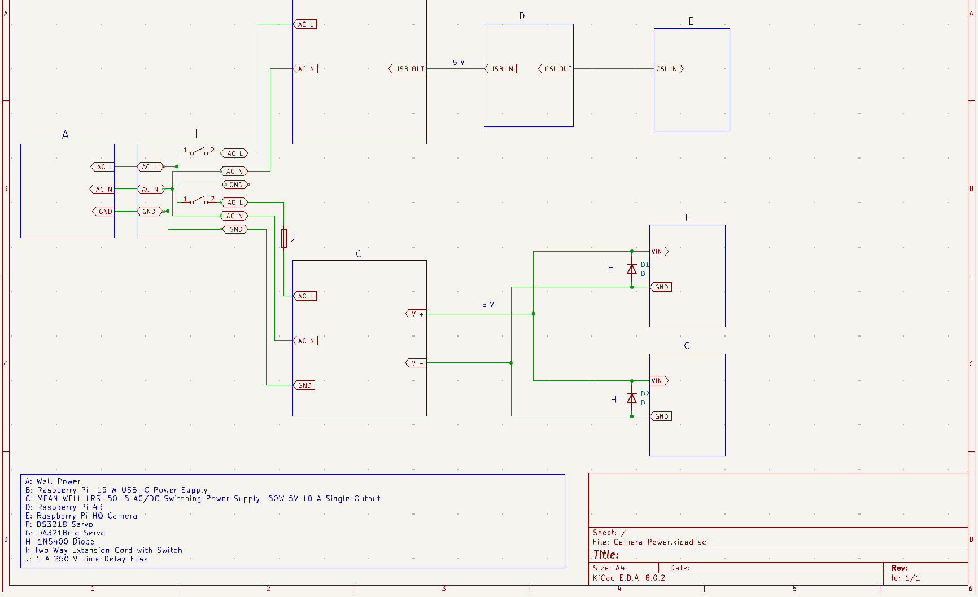
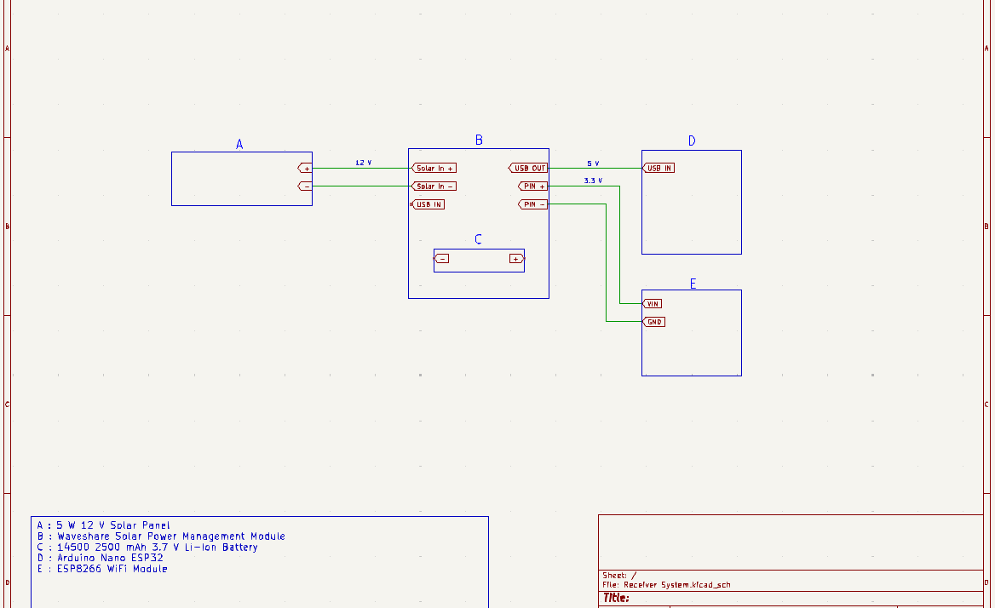
My Role in the Project
I designed two separate power systems for the project.
I was also designated as a “speaker.”
Notes:
The designs needed to be different due the camera and receiver systems not being located together.
I helped communicate with Dr. Austen for the team.

Slide 5
What went well
Team and Project Selection
Scope definition
Communication
Building and Testing the Power Systems
Dr. Austen as an advisor
Notes:
We did a good job selecting people we know work well together from previous coursework.
We also picked a project that suited the skills of our team.
From our first few meetings, we set a strong scope for our project deciding what would and would not be covered. This allowed us to continue without any confusion to delay the project.
As a group, we kept each other on task, reminded each other of due dates, and provided help where needed.
Due to the rigorous design process, putting together the components for both power systems and testing the system was not time consuming.
He helped keep the project on track and would help with things that I did not consider.

Slide 6
What went poorly and Addressing Problems
Detailed Design
Time management
Dr. Austen as an advisor
Notes:
The design process was much heavier than I anticipated. Much of this was due to having two separate designs.
I should have worked more over summer to not lose as many points due to being behind on signoffs.
I could have managed my time better with less procrastination to stay well ahead of deadlines.
He is a stickler for the details, which I occasionally overlooked.
I should have paid better attention to units.

Slide 7
Best Practices for Future Projects
Well Established Scope
Documentation
Communication
Notes:
The scope set for the project helped communication and made sure we did not have to significantly change the design due to an altered scope.
Proper documentation is very important to avoid unnecessary work and makes working as a team much easier.
Constant communication to make sure the entire team is on the same page is very useful.

Slide 8
Advice for Future Students
Stay Ahead of Due Dates
Pick a Project You Care About
Get everything in writing.
Notes:
Without procrastinating, you can reduce stress and avoid setbacks due to unexpected issues.
Our group did not love any of the project ideas, so we found more ideas that the group was interested in from Dr. Austen.
This helped motivate the group to work hard to achieve our goals, because we truly cared about the outcome of the project.

Slide 9
Knowledge or Skills Acquired
KiCad
GitHub
Design Process
Component Selction

Slide 10
Impact on Approach and Aspirations
Power Industry
Documentation
Design Process
Notes:
The project gave me more insight to smaller scale power.
I won’t use GitHub but may take a similar approach for my notes.
Dr. Austen helped me to consider things I may have overlooked.
In the workforce, this could be like talking to your supervisor with an idea you had.

Slide 11

Questions

